Slide 1
Software Reuse and Component-Based Software Engineering

Slide 2
Software Reuse
In most engineering disciplines, systems are designed by composition (building system out of components that have been used in other systems)
Software engineering has focused on custom development of components
To achieve better software quality, more quickly, at lower costs, software engineers are beginning to adopt systematic reuse as a design process

Slide 3
Types of Software Reuse
Application System Reuse
  reusing an entire application by incorporation of one application inside another (COTS reuse)
  development of application families (e.g. MS Office)
Component Reuse
  components (e.g. subsystems or single objects) of one application reused in another application
Function Reuse
  reusing software components that implement a single well-defined function

Slide 4
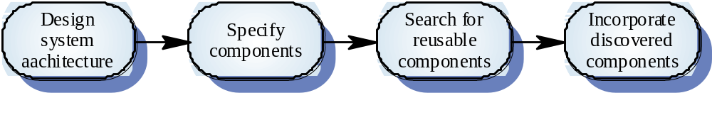
Opportunistic Reuse

Slide 5
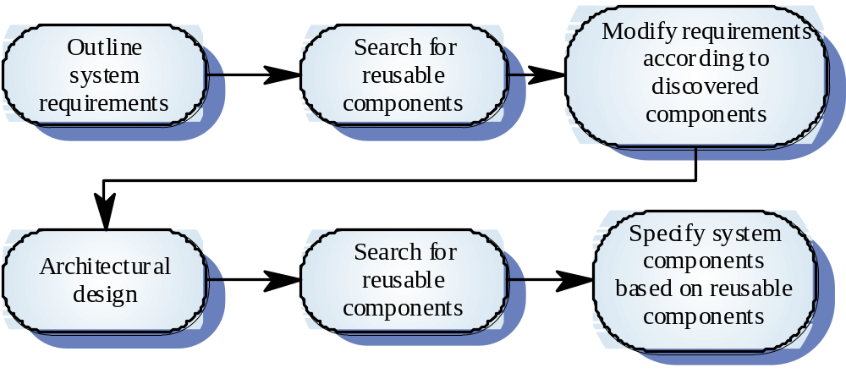
Development Reuse as a Goal

Slide 6
Benefits of Reuse
Increased Reliability
  components already exercised in working systems
Reduced Process Risk
  less uncertainty in development costs
Effective Use of Specialists
  reuse components instead of people
Standards Compliance
  embed standards in reusable components
Accelerated Development
  avoid custom development and speed up delivery

Slide 7
Requirements for Design with Reuse
You need to be able to find appropriate reusable components
You must be confident that that component you plan to reuse is reliable and will behave as expected
The components to be reused must be documented to allow them to be understood and modified (if necessary)

Slide 8
Reuse Problems
Increased maintenance costs
Lack of tool support
Pervasiveness of the “not invented here” syndrome
Need to create and maintain a component library
Finding and adapting reusable components

Slide 9
Component-Based Software Engineering
CBSE is an approach to software development that relies on reuse
CBSE emerged from the failure of object-oriented development to support reuse effectively
Objects (classes) are too specific and too detailed to support design for reuse work
Components are more abstract than classes and can be considered to be stand-alone service providers

Slide 10
Component Abstractions
Functional Abstractions
  component implements a single function (e.g. ln)
Casual Groupings
  component is part of a loosely related entities like declarations and functions
Data Abstractions
  abstract data types or objects
Cluster Abstractions
  component from group of cooperating objects
System Abstraction
  component is a self-contained system

Slide 11
Engineering of Component-Based Systems - part 1
Software team elicits system requirements
Architectural design is established
Team determines requirements are amenable to composition rather than construction
  Are commercial off-the-shelf (COTS) components available to implement the requirement?
  Are internally developed reusable components available to implement the requirement?
  Are the interfaces for available components compatible within in the proposed system architecture?
Team attempts to remove or modify requirements that cannot be implemented with COTS or in-house components

Slide 12
Engineering of Component-Based Systems - part 2
For those requirements that can be addressed with available components the following activities take place:
  component qualification
  component adaptation
  component composition
  component update
Detailed design activities commence for remainder of the system

Slide 13
Definition of Terms
Component Qualification
  candidate components are identified based on services provided and means by which consumers access them
Component Adaptation
  candidate components are modified to meet the needs of the architecture or discarded
Component Composition
  architecture dictates the composition of the end product from the nature of the connections and coordination mechanisms
Component Update
  updating systems that include COTS is made more complicated by the fact that a COTS developer must be involved

Slide 14
Commercial Off-the-Shelf Software
COTS systems are usually complete applications library the off an applications programming interface (API)
Building large systems by integrating COTS components is a viable development strategy for some types of systems (e.g. E-commerce or video games)

Slide 15
Reusable Components
Tradeoff between reusability and usability
  generic components can be highly reusable
  reusable components are likely to be more complex and harder to use
Development costs are higher for reusable components than application specific components
Generic components may be less space-efficient and have longer execution times than their application specific analogs

